Slide 1
CIS 4517/5517: Data Intensive and Cloud Computing Finding similar items
Dr. Xubin He
Computer and Information Sciences
Temple University

Slide 2
Credit:
Most slides are adapted from: http://www.mmds.org
Mining of Massive Datasets, by Jure Leskovec, Anand Rajaraman, Jeff Ullman
Read Chapter 3 of “Mining of Massive Datasets” at http://www.mmds.org

Slide 3
Big Data Analytics
Goal: Generalizations
A model or summarization of the data.
Data/Workflow Frameworks
Analyses and Algorithms
Similarity Search
Hadoop File System
Spark
Hypothesis Testing
Streaming
Graph Analysis
MapReduce
Recommendation Systems
Tensorflow
Deep Learning

Slide 4
Goals
Many Web-mining problems can be expressed as finding “similar” sets:
Pages with similar words, e.g., for classification by topic.
NetFlix users with similar tastes in movies, for recommendation systems/movies with similar sets of fans.
Images of related events.
Related/similar news articles

Slide 5
Motivating problem
Find duplicate and near-duplicate documents from a web crawl.
If we wanted exact duplicates we could do this by hashing
We will see how to adapt this technique for near duplicate documents

Slide 6
Distance Measures
Goal: Find near-neighbors in high-dim. space
We formally define “near neighbors” as points that are a “small distance” apart
For each application, we first need to define what “distance” means
Today: Jaccard distance/similarity
The Jaccard similarity of two sets is the size of their intersection divided by the size of their union: sim(C₁, C₂) = |C₁∩C₂|/|C₁∪C₂|
Jaccard distance: d(C₁, C₂) = 1 - |C₁∩C₂|/|C₁∪C₂|
3 in intersection
8 in union
Jaccard similarity= 3/8
Jaccard distance = 5/8

Slide 7
Jaccard similarity for bags
The Jaccard similarity for bags B and C is defined by counting an element n times in the intersection if n is the minimum of the number of times the element appears in B and C. In the union, we count the element the sum of the number of times it appears in B and in C.
Bags allow duplicate items.
The size of the union of two bags is always the sum of the sizes of the two bags
Example: The bag-similarity of bags {a, a, a, b} and {a, a, b, b, c} is 1/3, why?
The highest possible Jaccard similarity for bags is ½, why?

Slide 8
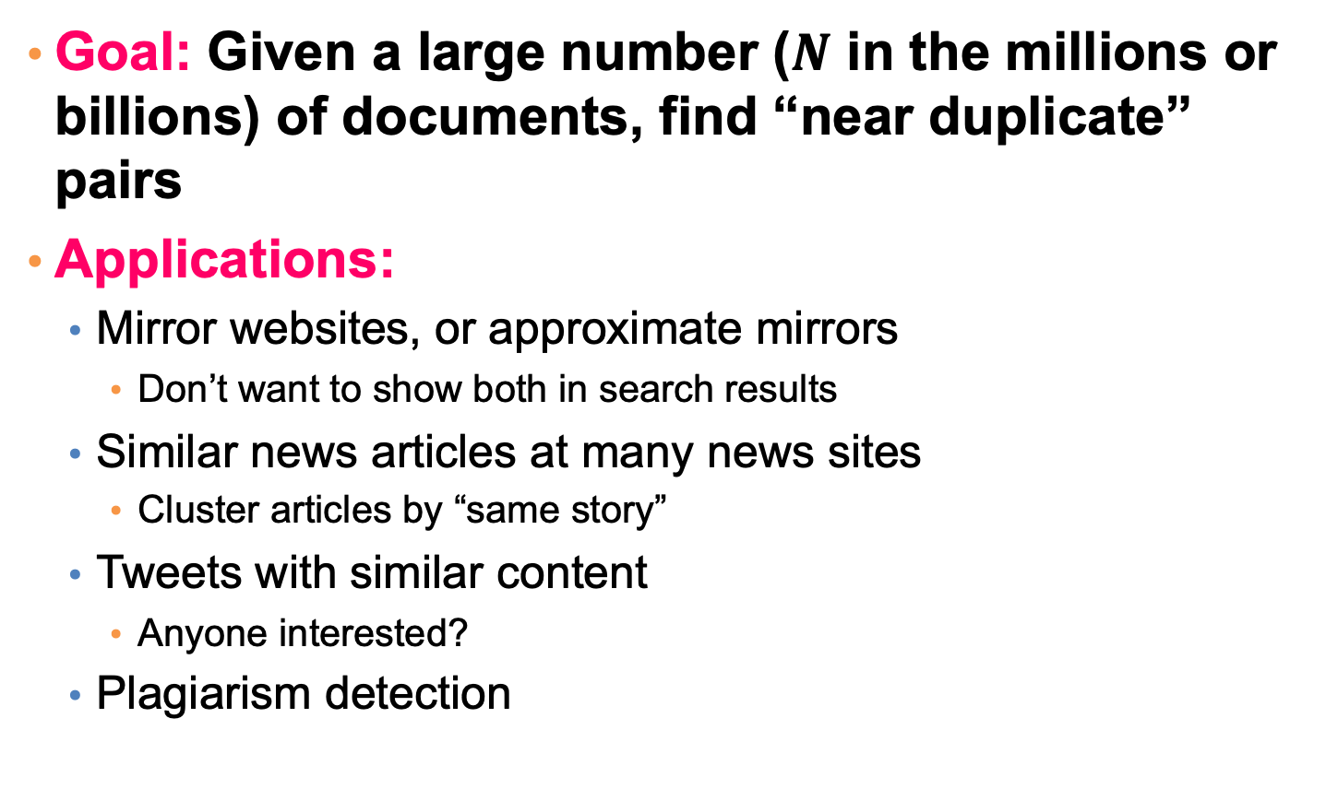
Task: Finding Similar Documents
Goal: Given a large number ($N$ in the millions or billions) of documents, find “near duplicate” pairs
Applications:
Mirror websites, or approximate mirrors
Don’t want to show both in search results
Similar news articles at many news sites
Cluster articles by “same story”
Tweets with similar content
Anyone interested?
Plagiarism detection

Slide 9
Main issues
What is the right representation of the document when we check for similarity?
E.g., representing a document as a set of characters will not do (why?)
When we have billions of documents, keeping the full text in memory is not an option.
We need to find a shorter representation
How do we do pairwise comparisons of billions of documents?
We need to find the candidate pairs in a cost-effective fashion.

Slide 10
3 Essential Steps for Similar Docs
Shingling: Convert documents to sets
Min-Hashing: Convert large sets to short signatures, while preserving similarity
Locality-Sensitive Hashing: Focus on pairs of signatures likely to be from similar documents
Candidate pairs!

Slide 11
The Big Picture
Candidate
pairs :
those pairs
of signatures
that we need
to test for
similarity.
Shingling
Minhash-
ing
Locality-
sensitive
Hashing
Docu-
ments
The set
of strings
of length k
that appear
in the doc-
ument
Signatures :
short integer
vectors that
represent the
sets, and
reflect their
similarity

Slide 12
Documents as High-Dim Data
Step 1: Shingling: Convert documents to sets
Simple approaches:
Document = set of words appearing in document
Document = set of “important” words
Don’t work well for this application. Why?
Need to account for ordering of words!
A different way: Shingles!

Slide 13
Shingling
Shingle: a sequence of k contiguous characters
a rose is a rose is a rose
a rose is
rose is a
rose is a
ose is a r
se is a ro
e is a ros
is a rose
is a rose
s a rose i
a rose is
a rose is

Slide 14
Shingling
Shingle: a sequence of k contiguous characters
a rose is a rose is a rose
a rose is
rose is a
rose is a
ose is a r
se is a ro
e is a ros
is a rose
is a rose
s a rose i
a rose is
a rose is
a rose is
rose is a
rose is a
ose is a r
se is a ro
e is a ros
is a rose
is a rose
s a rose i
a rose is

Slide 15
Define: Shingles
A k-shingle (or k-gram) for a document is a sequence of k tokens that appears in the doc
Tokens can be characters, words or something else, depending on the application
Assume tokens = characters for examples
Example: k=2; document D₁ = abcab Set of 2-shingles: S(D₁) = {ab, bc, ca}
Option: Shingles as a bag (multiset), count ab twice: S’(D₁) = {ab, bc, ca, ab}

Slide 16
Compressing Shingles
To compress long shingles, we can hash them to (say) 4 bytes
k-shingle needs k bytes.
Represent a document by the set of hash values of its k-shingles
Idea: Two documents could (rarely) appear to have shingles in common, when in fact only the hash-values were shared
Example: k=2; document D₁= abcab Set of 2-shingles: S(D₁) = {ab, bc, ca} Hash the singles: h(D₁) = {1, 3, 4}

Slide 17
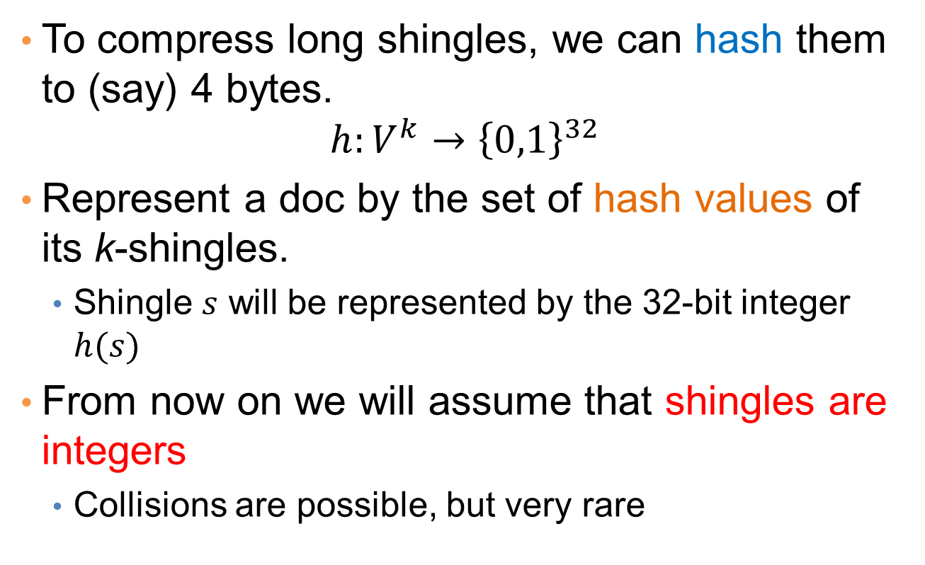
Shingles: Compression Option
To compress long shingles, we can hash them to (say) 4 bytes.
$$h:V^{k}→{\left\{0,1\right\}}^{32}$$
Represent a doc by the set of hash values of its k-shingles.
Shingle $s$ will be represented by the 32-bit integer $h(s)$
From now on we will assume that shingles are integers
Collisions are possible, but very rare

Slide 18
Fingerprinting
Hash shingles to 32-bit integers
Set of Shingles
Set of 32-bit integers
Hash function
a rose is
rose is a
rose is a
ose is a r
se is a ro
e is a ros
is a rose
is a rose
s a rose i
a rose is
1234
2345
3456
4567
5678
6789
7890
8901
9012
0123

Slide 19
Working Assumption
Documents that have lots of shingles in common have similar text, even if the text appears in different order.
NOTE: you must pick k large enough, or most documents will have most shingles.
Extreme case k = 1: all documents are the same
k = 5 is OK for short documents;
k = 10 is better for long documents.
Alternative ways to define shingles:
Use words instead of characters
Anchor on stop words (to avoid templates, read section 3.8.6)

Slide 20
Similarity Metric for Shingles
Document D₁ is a set of its k-shingles C₁=S(D₁)
Equivalently, each document is a 0/1 vector in the space of k-shingles
Each unique shingle is a dimension
Vectors are very sparse
A natural similarity measure is the Jaccard similarity:
sim(D₁, D₂) = |C₁∩C₂|/|C₁∪C₂|

Slide 21
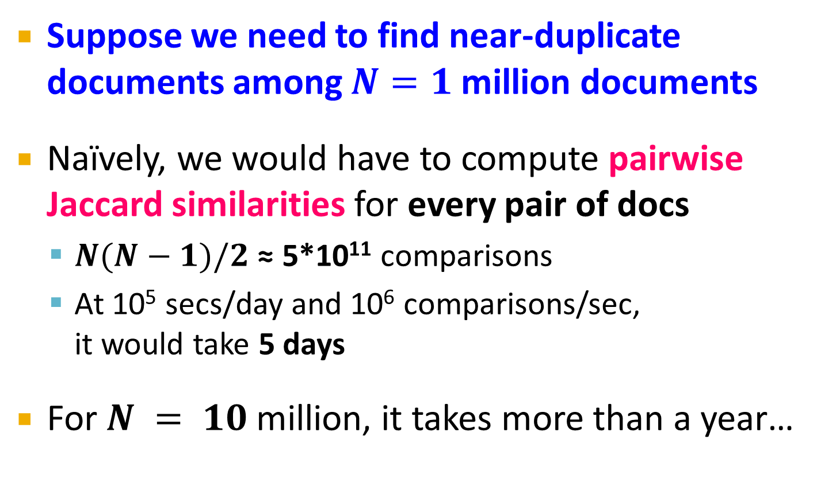
Motivation for Minhash/LSH
Suppose we need to find near-duplicate documents among $N=1$ million documents
Naïvely, we would have to compute pairwise Jaccard similarities for every pair of docs
$N(N−1)/2$ ≈ 5*10¹¹ comparisons
At 10⁵ secs/day and 10⁶ comparisons/sec, it would take 5 days
For $N = 10$ million, it takes more than a year…

Slide 22
MinHashing
Shingling
Min-Hash-
ing
Docu-
ment
The set
of strings
of length k
that appear
in the doc-
ument
Signatures:
short integer
vectors that
represent the
sets, and
reflect their
similarity
Step 2: Minhashing: Convert large sets to short signatures, while preserving similarity

Slide 23
Encoding Sets as Bit Vectors
Many similarity problems can be formalized as finding subsets that have significant intersection
Encode sets using 0/1 (bit, boolean) vectors
One dimension per element in the universal set
Interpret set intersection as bitwise AND, and set union as bitwise OR
Example: C₁ = 10111; C₂ = 10011
Size of intersection = 3; size of union = 4,
Jaccard similarity (not distance) = 3/4
Distance: d(C₁,C₂) = 1 – (Jaccard similarity) = 1/4

Slide 24
From Sets to Boolean Matrices
Rows = elements (shingles)
Columns = sets (documents)
1 in row e and column s if and only if e is a member of s
Column similarity is the Jaccard similarity of the corresponding sets (rows with value 1)
Typical matrix is sparse!
Each document is a column:
Example: sim(C₁ ,C₂) = ?
Size of intersection = 3; size of union = 6, Jaccard similarity (not distance) = 3/6
d(C₁,C₂) = 1 – (Jaccard similarity) = 3/6
Documents
1
1
1
0
1
1
0
1
0
1
0
1
Characteristic Matrix
0
0
0
1
Shingles
1
0
0
1
1
1
1
0
1
0
1
0

Slide 25
Outline: Finding Similar Columns
So far:
Documents → Sets of shingles
Represent sets as boolean vectors in a matrix
Next goal: Find similar columns while computing small signatures
Similarity of columns == similarity of signatures

Slide 26
Outline: Finding Similar Columns
Next Goal: Find similar columns, Small signatures
Naïve approach:
1) Signatures of columns: small summaries of columns
2) Examine pairs of signatures to find similar columns
Essential: Similarities of signatures and columns are related
3) Optional: Check that columns with similar signatures are really similar
Warnings:
Comparing all pairs may take too much time: Job for LSH
These methods can produce false negatives, and even false positives (if the optional check is not made)
False positive: Those dissimilar pairs of docs have similar signatures
False negative: Those similar pairs of docs don’t have similar signatures

Slide 27
Hashing Columns (Signatures)
Key idea: “hash” each column C to a small signature h(C), such that:
(1) h(C) is small enough that the signature fits in RAM
(2) sim(C₁, C₂) is the same as the “similarity” of signatures h(C₁) and h(C₂)
Goal: Find a hash function h(·) such that:
If sim(C₁,C₂) is high, then with high prob. h(C₁) = h(C₂)
If sim(C₁,C₂) is low, then with high prob. h(C₁) ≠ h(C₂)
Hash docs into buckets. Expect that “most” pairs of near duplicate docs hash into the same bucket!

Slide 28
Min-Hashing (Chapter 3.3.2)
Goal: Find a hash function h(·) such that:
if sim(C₁,C₂) is high, then with high prob. h(C₁) = h(C₂)
if sim(C₁,C₂) is low, then with high prob. h(C₁) ≠ h(C₂)
Clearly, the hash function depends on the similarity metric:
Not all similarity metrics have a suitable hash function
There is a suitable hash function for the Jaccard similarity: It is called Min-Hashing

Slide 29
Min-Hashing
Imagine the rows of the boolean matrix permuted under random permutation π
Define a “hash” function h_{π}(C) = the index of the first (in the permuted order π) row in which column C has value 1:
h_{π} (C) = min_{π} π(C)
Use several (e.g., 100) independent hash functions (that is, permutations) to create a signature of a column

Slide 30
Min-Hashing
Pick a random permutation of the rows (the universe U).
Define “hash” function for set S
h(S) = the index of the first row (in the permuted order) in which column S has 1.
or
h(S) = the index of the first element of S in the permuted order.
Use k (e.g., k = 100) independent random permutations to create a signature.

Slide 31
Example of minhash signatures
Input matrix
 | S₁ | S₂ | S₃ | S₄
A | 1 | 0 | 1 | 0
B | 1 | 0 | 0 | 1
C | 0 | 1 | 0 | 1
D | 0 | 1 | 0 | 1
E | 0 | 1 | 0 | 1
F | 1 | 0 | 1 | 0
G | 1 | 0 | 1 | 0
 |  | S₁ | S₂ | S₃ | S₄
1 | A | 1 | 0 | 1 | 0
2 | C | 0 | 1 | 0 | 1
3 | G | 1 | 0 | 1 | 0
4 | F | 1 | 0 | 1 | 0
5 | B | 1 | 0 | 0 | 1
6 | E | 0 | 1 | 0 | 1
7 | D | 0 | 1 | 0 | 1
A
C
G
F
B
E
D
1 | 2 | 1 | 2

Slide 32
Example of minhash signatures
Input matrix
 | S₁ | S₂ | S₃ | S₄
A | 1 | 0 | 1 | 0
B | 1 | 0 | 0 | 1
C | 0 | 1 | 0 | 1
D | 0 | 1 | 0 | 1
E | 0 | 1 | 0 | 1
F | 1 | 0 | 1 | 0
G | 1 | 0 | 1 | 0
 |  | S₁ | S₂ | S₃ | S₄
1 | D | 0 | 1 | 0 | 1
2 | B | 1 | 0 | 0 | 1
3 | A | 1 | 0 | 1 | 0
4 | C | 0 | 1 | 0 | 1
5 | F | 1 | 0 | 1 | 0
6 | G | 1 | 0 | 1 | 0
7 | E | 0 | 1 | 0 | 1
D
B
A
C
F
G
E
2 | 1 | 3 | 1

Slide 33
Example of minhash signatures
Input matrix
 | S₁ | S₂ | S₃ | S₄
A | 1 | 0 | 1 | 0
B | 1 | 0 | 0 | 1
C | 0 | 1 | 0 | 1
D | 0 | 1 | 0 | 1
E | 0 | 1 | 0 | 1
F | 1 | 0 | 1 | 0
G | 1 | 0 | 1 | 0
 |  | S₁ | S₂ | S₃ | S₄
1 | C | 0 | 1 | 0 | 1
2 | D | 0 | 1 | 0 | 1
3 | G | 1 | 0 | 1 | 0
4 | F | 1 | 0 | 1 | 0
5 | A | 1 | 0 | 1 | 0
6 | B | 1 | 0 | 0 | 1
7 | E | 0 | 1 | 0 | 1
C
D
G
F
A
B
E
3 | 1 | 3 | 1

Slide 34
Example of minhash signatures
Input matrix
 | S₁ | S₂ | S₃ | S₄
A | 1 | 0 | 1 | 0
B | 1 | 0 | 0 | 1
C | 0 | 1 | 0 | 1
D | 0 | 1 | 0 | 1
E | 0 | 1 | 0 | 1
F | 1 | 0 | 1 | 0
G | 1 | 0 | 1 | 0
Signature matrix
 | S₁ | S₂ | S₃ | S₄
h₁ | 1 | 2 | 1 | 2
h₂ | 2 | 1 | 3 | 1
h₃ | 3 | 1 | 3 | 1
≈
Sig(S) = vector of hash values
e.g., Sig(S₂) = [2,1,1]
Sig(S,i) = value of the i-th hash function for set S
E.g., Sig(S₂,3) = 1

Slide 35
Hash function Property
Pr(h(S₁) = h(S₂)) = Sim(S₁,S₂)
where the probability is over all choices of permutations.
Why?
The first row where one of the two sets has value 1 belongs to the union.
Recall that union contains rows with at least one 1.
We have equality if both sets have value 1, and this row belongs to the intersection

Slide 36
Example
Universe: U = {A,B,C,D,E,F,G}
X = {A,B,F,G}
Y = {A,E,F,G}
Union =
{A,B,E,F,G}
Intersection =
{A,F,G}
Rows C,D could be anywhere they do not affect the probability
 | X | Y
A | 1 | 1
B | 1 | 0
C | 0 | 0
D | 0 | 0
E | 0 | 1
F | 1 | 1
G | 1 | 1
 | X | Y
D | 0 | 0
C | 0 | 0
D
*
*
C
*
*
*

Slide 37
Example
Universe: U = {A,B,C,D,E,F,G}
X = {A,B,F,G}
Y = {A,E,F,G}
Union =
{A,B,E,F,G}
Intersection =
{A,F,G}
The * rows belong to the union
 | X | Y
A | 1 | 1
B | 1 | 0
C | 0 | 0
D | 0 | 0
E | 0 | 1
F | 1 | 1
G | 1 | 1
 | X | Y
D | 0 | 0
C | 0 | 0
D
*
*
C
*
*
*

Slide 38
Example
Universe: U = {A,B,C,D,E,F,G}
X = {A,B,F,G}
Y = {A,E,F,G}
Union =
{A,B,E,F,G}
Intersection =
{A,F,G}
The question is what is the value of the first * element
 | X | Y
A | 1 | 1
B | 1 | 0
C | 0 | 0
D | 0 | 0
E | 0 | 1
F | 1 | 1
G | 1 | 1
 | X | Y
D | 0 | 0
C | 0 | 0
D
*
*
C
*
*
*

Slide 39
Example
Universe: U = {A,B,C,D,E,F,G}
X = {A,B,F,G}
Y = {A,E,F,G}
Union =
{A,B,E,F,G}
Intersection =
{A,F,G}
If it belongs to the intersection then h(X) = h(Y)
 | X | Y
A | 1 | 1
B | 1 | 0
C | 0 | 0
D | 0 | 0
E | 0 | 1
F | 1 | 1
G | 1 | 1
 | X | Y
D | 0 | 0
C | 0 | 0
D
*
*
C
*
*
*

Slide 40
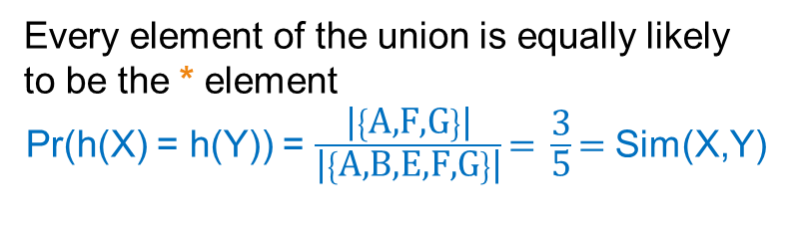
Example
Universe: U = {A,B,C,D,E,F,G}
X = {A,B,F,G}
Y = {A,E,F,G}
Union =
{A,B,E,F,G}
Intersection =
{A,F,G}
Every element of the union is equally likely to be the * element
Pr(h(X) = h(Y)) = $\frac{\text{|}\left\{\text{A}\text{,}\text{F}\text{,}\text{G}\right\}\text{|}}{\text{|}\left\{\text{A}\text{,}\text{B}\text{,}\text{E}\text{,}\text{F}\text{,}\text{G}\right\}\text{|}}\text{= }\frac{\text{3}}{\text{5}}\text{= }$Sim(X,Y)
 | X | Y
A | 1 | 1
B | 1 | 0
C | 0 | 0
D | 0 | 0
E | 0 | 1
F | 1 | 1
G | 1 | 1
 | X | Y
D | 0 | 0
C | 0 | 0
D
*
*
C
*
*
*

Slide 41
Similarity for Signatures
The similarity of signatures is the fraction of the hash functions in which they agree.
With multiple signatures we get a good approximation
 | S₁ | S₂ | S₃ | S₄
A | 1 | 0 | 1 | 0
B | 1 | 0 | 0 | 1
C | 0 | 1 | 0 | 1
D | 0 | 1 | 0 | 1
E | 0 | 1 | 0 | 1
F | 1 | 0 | 1 | 0
G | 1 | 0 | 1 | 0
Signature matrix
 | Actual | Sig
(S₁, S₂) | 0 | 0
(S₁, S₃) | 3/5 | 2/3
(S₁, S₄) | 1/7 | 0
(S₂, S₃) | 0 | 0
(S₂, S₄) | 3/4 | 1
(S₃, S₄) | 0 | 0
S₁ | S₂ | S₃ | S₄
1 | 2 | 1 | 2
2 | 1 | 3 | 1
3 | 1 | 3 | 1
≈
Zero similarity is preserved
High similarity is well approximated

Slide 42
Is it now feasible?
Assume a billion rows
Hard to pick a random permutation of 1…billion
Even representing a random permutation requires 1 billion entries!!!
Too many comparisons to afford☹

Slide 43
Being more practical
Instead of permuting the rows we will apply a hash function that maps the rows to a new (possibly larger) space
The value of the hash function is the position of the row in the new order (permutation).
Each set is represented by the smallest hash value among the elements in the set
The space of the hash functions should be such that if we select one at random each element (row) has equal probability to have the smallest value
Min-wise independent hash functions

Slide 44
Algorithm – One set, one hash function
Computing Sig(S,i) for a single column S and single hash function h_{i}
for each row r
compute h_{i} (r )
if column S has 1 in row r
Sig(S,i) = Sig(S,i) < h_{i} (r) ? Sig(S,i): h_{i} (r);
In practice only the rows (shingles) that appear in the data
h_{i} (r) = index of row r in permutation
S contains row r
Find the row r with minimum index
Sig(S,i) will become the smallest value of h_{i}(r) among all rows (shingles) for which column S has value 1 (shingle belongs in S); i.e., h_{i} (r) gives the min index for the i-th permutation

Slide 45
How to pick a random hash function h(x)?
Universal hashing:
h_{a,b}(x)=((a·x+b) mod p) mod N
where:
a,b … random integers
p … prime number (p > N)

Slide 46
Algorithm – All sets, k hash functions
Pick k=100 hash functions (h₁,…,h_{k})
for each row r
for each hash function h_{i}
compute h_{i} (r )
for each column S that has 1 in row r
Sig(S,i) = Sig(S,i) < h_{i} (r) ? Sig(S,i): h_{i} (r);
In practice this means selecting the hash function parameters
Compute h_{i} (r) only once for all sets

Slide 47
Example
Sig1 Sig2
h ∞ ∞
g ∞ ∞
h(0) = 1 1 ∞
g(0) = 3 3 ∞
x
0
1
2
3
4
Row S1 S2
A 1 0
B 0 1
C 1 1
D 1 0
E 0 1
h(x)
1
2
3
4
0
g(x)
3
0
2
4
1
h(1) = 2 1 2
g(1) = 0 3 0
h(2) = 3 1 2
g(2) = 2 2 0
h(3) = 4 1 2
g(3) = 4 2 0
h(x) = x+1 mod 5
g(x) = 2x+3 mod 5
h(Row)
0
1
2
3
4
Row S1 S2
E 0 1
A 1 0
B 0 1
C 1 1
D 1 0
g(Row)
0
1
2
3
4
Row S1 S2
B 0 1
E 0 1
C 1 0
A 1 1
D 1 0
h(4) = 0 1 0
g(4) = 1 2 0

Slide 48
Example
Sig1 Sig2
h ∞ ∞
g ∞ ∞
h(0) = 1 1 ∞
g(0) = 3 3 ∞
x
0
1
2
3
4
Row S1 S2
A 1 0
B 0 1
C 1 1
D 1 0
E 0 1
h(x)
1
2
3
4
0
g(x)
3
0
2
4
1
h(1) = 2 1 2
g(1) = 0 3 0
h(2) = 3 1 2
g(2) = 2 2 0
h(3) = 4 1 2
g(3) = 4 2 0
h(x) = x+1 mod 5
g(x) = 2x+3 mod 5
h(Row)
0
1
2
3
4
Row S1 S2
E 0 1
A 1 0
B 0 1
C 1 1
D 1 0
g(Row)
0
1
2
3
4
Row S1 S2
B 0 1
E 0 1
C 1 0
A 1 1
D 1 0
h(4) = 0 1 0
g(4) = 1 2 0

Slide 49
Implementation
Often, data is given by column, not row.
E.g., columns = documents, rows = shingles.
If so, sort matrix once so it is by row.
And always compute h_{i} (r ) only once for each row.

Slide 50
Candidate
pairs:
those pairs
of signatures
that we need
to test for
similarity
Shingling
Min-Hash-
ing
Locality-
Sensitive
Hashing
Docu-
ment
The set
of strings
of length k
that appear
in the doc-
ument
Signatures:
short integer
vectors that
represent the
sets, and
reflect their
similarity
Step 3: Locality-Sensitive Hashing: Focus on pairs of signatures likely to be from similar documents

Slide 51
LSH: First Cut
Goal: Find documents with Jaccard similarity at least s (for some similarity threshold, e.g., s=0.8)
LSH – General idea: Use a function f(x,y) that tells whether x and y is a candidate pair: a pair of elements whose similarity must be evaluated
For Min-Hash matrices:
Hash columns of signature matrix M to many buckets
Each pair of documents that hashes into the same bucket is a candidate pair

Slide 52
Candidates from Min-Hash
Pick a similarity threshold s (0 < s < 1)
Columns x and y of M are a candidate pair if their signatures agree on at least fraction s of their rows: M (i, x) = M (i, y) for at least frac. s values of i
We expect documents x and y to have the same (Jaccard) similarity as their signatures

Slide 53
LSH for Min-Hash
Big idea: Hash columns of signature matrix M several times
Arrange that (only) similar columns are likely to hash to the same bucket, with high probability
Candidate pairs are those that hash to the same bucket

Slide 54
Finding similar pairs
Problem: Find all pairs of documents with similarity at least t = 0.8
While the signatures of all columns may fit in main memory, comparing the signatures of all pairs of columns is quadratic in the number of columns.
Example: 10⁶ columns implies 5*10¹¹ column-comparisons.
At 1 microsecond/comparison: 6 days.

Slide 55
Locality-Sensitive Hashing
What we want: a function f(X,Y) that tells whether or not X and Y is a candidate pair: a pair of elements whose similarity must be evaluated.
A simple idea: X and Y are a candidate pair if they have the same min-hash signature.
Easy to test by hashing the signatures.
Similar sets are more likely to have the same signature.
Likely to produce many false negatives.
Requiring full match of signature is strict, some similar sets will be lost.
Improvement: Compute multiple signatures; candidate pairs should have at least one common signature.
Reduce the probability for false negatives.
! Multiple levels of Hashing!

Slide 56
Signature matrix reminder
Prob(Sig(S,i) == Sig(S’,i)) = sim(S,S’)
Sig(S,i)
Sig(S’,i)
hash function i
n hash functions
Sig(S):
signature for set S
signature for set S’
Matrix M

Slide 57
Partition into Bands – (1)
Divide the signature matrix Sig into b bands of r rows.
Each band is a mini-signature with r hash functions.

Slide 58
Partitioning into bands
n = b*r hash functions
r rows
per band
b bands
b mini-signatures
One
signature
Matrix Sig

Slide 59
Partition into Bands – (2)
Divide the signature matrix Sig into b bands of r rows.
Each band is a mini-signature with r hash functions.
For each band, hash the mini-signature to a hash table with k buckets.
Make k as large as possible so that mini-signatures that hash to the same bucket are almost certainly identical.

Slide 60
Hash Table
Columns 2 and 6
are (almost certainly) identical.
Columns 6 and 7 are
surely different.
Matrix M
1
2
3
4
5
6
7
r rows
b bands

Slide 61
Partition into Bands – (3)
Divide the signature matrix Sig into b bands of r rows.
Each band is a mini-signature with r hash functions.
For each band, hash the mini-signature to a hash table with k buckets.
Make k as large as possible so that mini-signatures that hash to the same bucket are almost certainly identical.
Candidate column pairs are those that hash to the same bucket for at least 1 band.
Tune b and r to catch most similar pairs, but few non-similar pairs.

Slide 62
Analysis of LSH – What We Want
Probability
= 1 if s > t
Probability
of sharing
a bucket
No chance
if s < t
t
Similarity s of two sets

Slide 63
What One Band of One Row Gives You
Single hash signature
Probability
of sharing
a bucket
Remember:
probability of
equal hash-values
= similarity
t
Prob(Sig(S,i) == Sig(S’,i)) = sim(S,S’)
Similarity s of two sets

Slide 64
What b Bands of r Rows Gives You (3.4.2)
At least
one band
identical
No bands
identical
(
s ^{r}
t ~ (1/b)^{1/r}
1 -
1 -
)^{b}
Probability
of sharing
a bucket
Some row
of a band
unequal
All rows
of a band
are equal
t
Similarity s of two sets

Slide 65
Example: b = 20; r = 5
s | 1-(1-s^{r})^{b}
.2 | .006
.3 | .047
.4 | .186
.5 | .470
.6 | .802
.7 | .975
.8 | .9996
That is, if we consider two documents with 80% similarity, then in any one band, they have only about a 33% chance of agreeing in all five rows and thus becoming a candidate pair. However, there are 20 bands and thus 20 chances to become a candidate.
Only roughly one in 3000 pairs that are as high as 80% similar will fail to become a candidate pair and thus be a false negative.

Slide 66
Suppose S₁, S₂ are 80% Similar
We want all 80%-similar pairs. Choose 20 bands of 5 integers/band.
Probability S₁, S₂ identical in one particular band:
(0.8)⁵ = 0.328.
Probability S₁, S₂ are not similar in any of the 20 bands:
(1-0.328)²⁰ = 0.00035
i.e., about 1/3000-th of the 80%-similar column pairs are false negatives.
Probability S₁, S₂ are similar in at least one of the 20 bands:
1-0.00035 = 0.999

Slide 67
C₁, C₂ are 30% Similar
Find pairs of ≥ s=0.8 similarity, set b=20, r=5
Assume: sim(C₁, C₂) = 0.3
Since sim(C₁, C₂) < s we want C₁, C₂ to hash to NO common buckets (all bands should be different)
Probability C₁, C₂ identical in one particular band: (0.3)⁵ = 0.00243
Probability C₁, C₂ identical in at least 1 of 20 bands: 1 - (1 - 0.00243)²⁰ = 0.0474
In other words, approximately 4.74% pairs of docs with similarity 30% end up becoming candidate pairs
They are false positives since we will have to examine them (they are candidate pairs) but then it will turn out their similarity is below threshold s

Slide 68
LSH Summary
Tune to get almost all pairs with similar signatures, but eliminate most pairs that do not have similar signatures.
Check in main memory that candidate pairs really do have similar signatures.
Optional: In another pass through data, check that the remaining candidate pairs really represent similar sets .

Slide 69
Applications of LSH (Section 3.8)
Entity Matching/Record Linkage:
Matching data records that refer to the same real-world entity, e.g., the same person.
News Article
Focusing on core news while ignoring all the extraneous material such as ads and newspaper-specific material.
Advertising Matching
Image Search
Fingerprints

Slide 70
Locality-sensitive hashing (LSH)
Big Picture: Construct hash functions h: R^{d}→ U such that for any pair of points p, q, for distance function D we have:
If D(p,q)≤r, then Pr[h(p)=h(q)] ≥ α is high
If D(p,q)≥cr, then Pr[h(p)=h(q)] ≤ β is small
Then, we can find close pairs by hashing
LSH is a general framework: for a given distance function D we need to find the right h
h is (r,cr, α, β)-sensitive

Slide 71
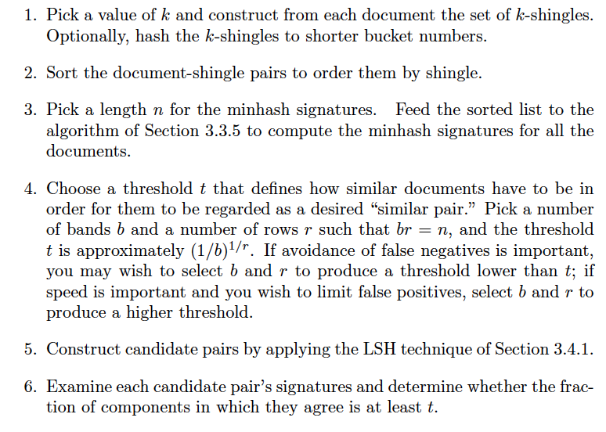
Combining all together: finding the set of candidate pairs for similar documents and then discovering the truly similar documents among them.

Slide 72
Next
Guest lectures from two industry experts

